Slide 1
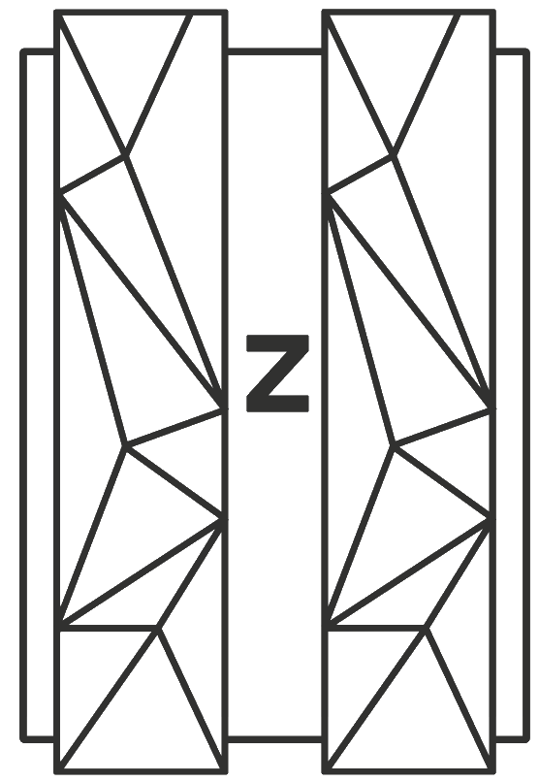
Project Charter
Client Name
Jane Doe | Client Services Lead | dd-mmm-yyyy

Slide 2
Agenda
 | Project Scope
 | Project Milestone Due Dates
 | PopUp Platform Delphix Data & Compliance Platform: Value Framework
 | Project Objectives & Outcomes
 | Project Roles: PopUp & Delphix
 | Project Roles: Client
 | Agile Implementation Approach
 | PopUp & Delphix Architecture & Best Practices
 | Project Deliverables
 | Important Links
 | Next Steps / PopUp & Delphix Support / eLearning
 | Customer Success
Notes:
PopUp Mainframe delivers Red Hat Enterprise Linux with IBM’s zD&T mainframe emulator pre-installed, preconfigured and ready to work on any x86 hardware. It can be installed and run on a desktop, server (in a VM) and the Cloud
PopUp Mainframe enables the instant rollout of a mainframe for development, testing, R&D, software evaluation or training – integrated seamlessly with your IT estate.
PopUp Mainframe enables organizations to include mainframe in their cloud strategy. Itre moves the need for siloed mainframe skills – making mainframe environment self-service a reality.

Slide 3
Project Objectives
The main objectives are …
Notes:
PopUp Mainframe delivers Red Hat Enterprise Linux with IBM’s zD&T mainframe emulator pre-installed, preconfigured and ready to work on any x86 hardware. It can be installed and run on a desktop, server (in a VM) and the Cloud
PopUp Mainframe enables the instant rollout of a mainframe for development, testing, R&D, software evaluation or training – integrated seamlessly with your IT estate.
PopUp Mainframe enables organizations to include mainframe in their cloud strategy. Itre moves the need for siloed mainframe skills – making mainframe environment self-service a reality.

Slide 4
Project Team
Client
Project Sponsor:
Project Manager:
Lead Architect:
PopUp & Delphix
Account Executive
Solution Engineers:
Technical team:
Notes:
PopUp Mainframe delivers Red Hat Enterprise Linux with IBM’s zD&T mainframe emulator pre-installed, preconfigured and ready to work on any x86 hardware. It can be installed and run on a desktop, server (in a VM) and the Cloud
PopUp Mainframe enables the instant rollout of a mainframe for development, testing, R&D, software evaluation or training – integrated seamlessly with your IT estate.
PopUp Mainframe enables organizations to include mainframe in their cloud strategy. Itre moves the need for siloed mainframe skills – making mainframe environment self-service a reality.

Slide 5
Project Milestone Dates
Project Startup Complete
Architecture Complete
Infrastructure Complete
Virtualization Application 1
Client Acceptance Application 1
Virtualization Application 2
Client Acceptance Application 2
Virtualization Application 3
Client Acceptance Application 3
Project Complete
Notes:
PopUp Mainframe delivers Red Hat Enterprise Linux with IBM’s zD&T mainframe emulator pre-installed, preconfigured and ready to work on any x86 hardware. It can be installed and run on a desktop, server (in a VM) and the Cloud
PopUp Mainframe enables the instant rollout of a mainframe for development, testing, R&D, software evaluation or training – integrated seamlessly with your IT estate.
PopUp Mainframe enables organizations to include mainframe in their cloud strategy. Itre moves the need for siloed mainframe skills – making mainframe environment self-service a reality.

Slide 6
Project Scope Details
Scope:
  Mainframe Virtualization with masked data discovery
  Complete the virtualization of Mainframe Application 1 based on out of box functionality
  Virtualization of Application 2 and basic use case based on out of box functionality.
  Virtualization of Application 3 and basic use case based on out of box functionality.
Notes:
PopUp Mainframe delivers Red Hat Enterprise Linux with IBM’s zD&T mainframe emulator pre-installed, preconfigured and ready to work on any x86 hardware. It can be installed and run on a desktop, server (in a VM) and the Cloud
PopUp Mainframe enables the instant rollout of a mainframe for development, testing, R&D, software evaluation or training – integrated seamlessly with your IT estate.
PopUp Mainframe enables organizations to include mainframe in their cloud strategy. Itre moves the need for siloed mainframe skills – making mainframe environment self-service a reality.

Slide 7
Project Assumptions
The key assumptions are …
Notes:
PopUp Mainframe delivers Red Hat Enterprise Linux with IBM’s zD&T mainframe emulator pre-installed, preconfigured and ready to work on any x86 hardware. It can be installed and run on a desktop, server (in a VM) and the Cloud
PopUp Mainframe enables the instant rollout of a mainframe for development, testing, R&D, software evaluation or training – integrated seamlessly with your IT estate.
PopUp Mainframe enables organizations to include mainframe in their cloud strategy. Itre moves the need for siloed mainframe skills – making mainframe environment self-service a reality.

Slide 8
Out of Scope
Any scope not called out above and any activities not included in Section 2 below are considered to be out of scope, including, but not limited to:
Assistance with automation of data delivery processes (e.g., automation of source database ingestion, virtual databases provisioning, masking, replication, etc.).
Assistance with infrastructure preparation beyond providing specifications and best practice guidance.
Management and logistics on Customer’s physical databases or files.
Virtualization of distributed data sources (e.g., Oracle, MSSQL)
Writing any mainframe programs or JCLs that are related to the applications in scope.
Travel to Customer facility.
Notes:
PopUp Mainframe delivers Red Hat Enterprise Linux with IBM’s zD&T mainframe emulator pre-installed, preconfigured and ready to work on any x86 hardware. It can be installed and run on a desktop, server (in a VM) and the Cloud
PopUp Mainframe enables the instant rollout of a mainframe for development, testing, R&D, software evaluation or training – integrated seamlessly with your IT estate.
PopUp Mainframe enables organizations to include mainframe in their cloud strategy. Itre moves the need for siloed mainframe skills – making mainframe environment self-service a reality.

Slide 9
Architecture Overview – General Logical Architecture
Notes:
PopUp Mainframe delivers Red Hat Enterprise Linux with IBM’s zD&T mainframe emulator pre-installed, preconfigured and ready to work on any x86 hardware. It can be installed and run on a desktop, server (in a VM) and the Cloud
PopUp Mainframe enables the instant rollout of a mainframe for development, testing, R&D, software evaluation or training – integrated seamlessly with your IT estate.
PopUp Mainframe enables organizations to include mainframe in their cloud strategy. Itre moves the need for siloed mainframe skills – making mainframe environment self-service a reality.

Slide 10
Architecture Overview – Masking on the Physical Mainframe
Notes:
PopUp Mainframe delivers Red Hat Enterprise Linux with IBM’s zD&T mainframe emulator pre-installed, preconfigured and ready to work on any x86 hardware. It can be installed and run on a desktop, server (in a VM) and the Cloud
PopUp Mainframe enables the instant rollout of a mainframe for development, testing, R&D, software evaluation or training – integrated seamlessly with your IT estate.
PopUp Mainframe enables organizations to include mainframe in their cloud strategy. Itre moves the need for siloed mainframe skills – making mainframe environment self-service a reality.

Slide 11
Architecture Overview – Migration of Masked Data and Virtualization
Notes:
PopUp Mainframe delivers Red Hat Enterprise Linux with IBM’s zD&T mainframe emulator pre-installed, preconfigured and ready to work on any x86 hardware. It can be installed and run on a desktop, server (in a VM) and the Cloud
PopUp Mainframe enables the instant rollout of a mainframe for development, testing, R&D, software evaluation or training – integrated seamlessly with your IT estate.
PopUp Mainframe enables organizations to include mainframe in their cloud strategy. Itre moves the need for siloed mainframe skills – making mainframe environment self-service a reality.

Slide 12
VMWare Prerequisites
VMWare Prerequisites for PopUp Mainframe
VMWare Prerequisites for Delphix Virtualization
VMWare Prerequisites for PopUp License Server
VMWare Prerequisites for PopUp Virtual
VMWare Prerequisites for Popup Masking
Notes:
PopUp Mainframe delivers Red Hat Enterprise Linux with IBM’s zD&T mainframe emulator pre-installed, preconfigured and ready to work on any x86 hardware. It can be installed and run on a desktop, server (in a VM) and the Cloud
PopUp Mainframe enables the instant rollout of a mainframe for development, testing, R&D, software evaluation or training – integrated seamlessly with your IT estate.
PopUp Mainframe enables organizations to include mainframe in their cloud strategy. Itre moves the need for siloed mainframe skills – making mainframe environment self-service a reality.

Slide 13
Project Deliverables
Project Charter | Contains the project success criteria, scope, milestone due dates and team assignments.
Project Plan Template | Contains the tasks associated with each project stage, resource assignments, and due dates.
Architecture Blueprint | Contains infrastructure (compute, network, memory and storage) requirements for PopUp & Delphix Software and deployment best practices based on measured workload and capacity metrics.
Install Guide | Contains information about the PopUp & Delphix installation.
Technical Configuration Summary | Contains a summary of the technical configurations made during the implementation with accompanying screen-shots.
Engagement Summary | Summarizes the outcomes of the project for Customer’s Executive Sponsor(s) and Project Manager.
Status Meetings: Mon, Wed and Fri at XX
Notes:
PopUp Mainframe delivers Red Hat Enterprise Linux with IBM’s zD&T mainframe emulator pre-installed, preconfigured and ready to work on any x86 hardware. It can be installed and run on a desktop, server (in a VM) and the Cloud
PopUp Mainframe enables the instant rollout of a mainframe for development, testing, R&D, software evaluation or training – integrated seamlessly with your IT estate.
PopUp Mainframe enables organizations to include mainframe in their cloud strategy. Itre moves the need for siloed mainframe skills – making mainframe environment self-service a reality.

Slide 14
Next Steps
Notes:
PopUp Mainframe delivers Red Hat Enterprise Linux with IBM’s zD&T mainframe emulator pre-installed, preconfigured and ready to work on any x86 hardware. It can be installed and run on a desktop, server (in a VM) and the Cloud
PopUp Mainframe enables the instant rollout of a mainframe for development, testing, R&D, software evaluation or training – integrated seamlessly with your IT estate.
PopUp Mainframe enables organizations to include mainframe in their cloud strategy. Itre moves the need for siloed mainframe skills – making mainframe environment self-service a reality.

